Slide 1
INDEX
Problem Statement, Domain keywords
Objectives
Outcomes
Software / Hardware required
Design/ Block Diagram
Test Cases
Demo
Conclusion
Questions / Answers
Future scope

Slide 2
Problem Statement :
An Engineering Class Owner/Tutor wants an application for the analysis of his students by the tests conducted.
The subjects taught are Mathematics-1 and Engineering Graphics.
The reports of each student according to subjects are to be made available to him.
According to the reports, data analysis should be made for better understanding of students' performances.
For this purpose, data analysis techniques are to be applied using python.
Also direct results in the form of mails are to be sent.

Slide 3
Objectives :
To maintain all the accounts of the students in digital form from enrollment up to the end of the study.
To make information accessible to the Admins at the desk in just a click away.
To have centralized control of records to the students and monitor changes in the records.
To ease the process of understanding students' performances with the help of data analysis technique.
Send results of the students in the form of Emails.

Slide 4
Outcomes:
The owner will be able to handle the course wise data of the students.
Automated Email system will be made available to the owner for direct and formal contact with the students/parents.
Simple and accurate results in the form of Graph will be displayed for ease in analysis of student performance.
Ease in planning for teaching of each students according to reports.
Personalized attention according to strengths And weaknesses of students.

Slide 5
Software and Hardware required:
Python Django
Atom text editor
Sublime text editor
A Computer System
Internet Connection
Data provided by Sponsor
Disk space: 2 to 3 GB
Processors: Intel Atom® processor or Intel® Core™ i3 processor.
Domain Keywords:
Centralized Control
Easy Maintenance
Admin module
Student module
Email module

Slide 6
Design/Block Diagram:
Login and Register
can
can
Admin
Database
Student
View and Delete
Create
Create and Enter
Display and View
Tests and their Analysis Graphs
Send Mails
Receive Mails

Slide 7
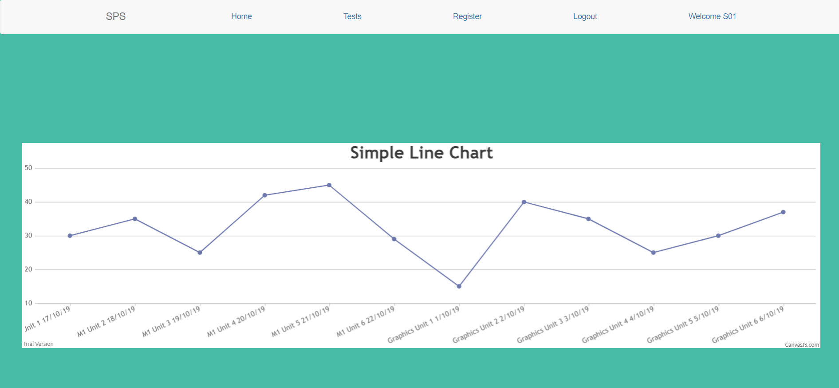
Test Cases:

Slide 8
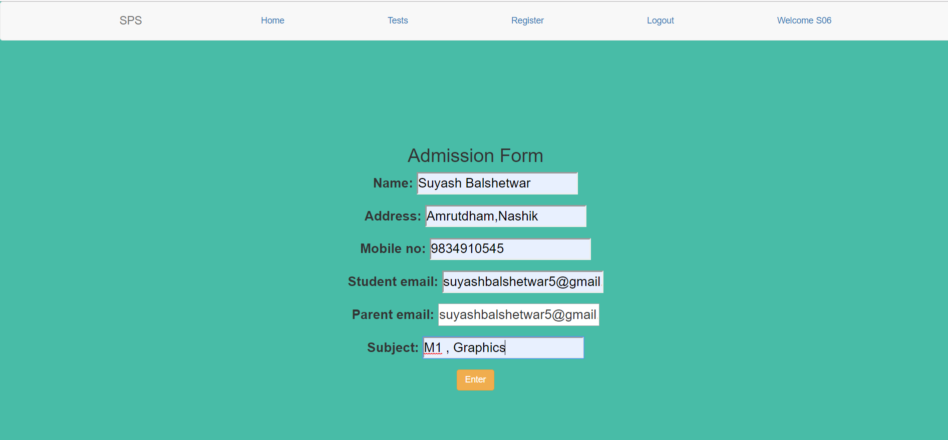
Test Cases:

Slide 9
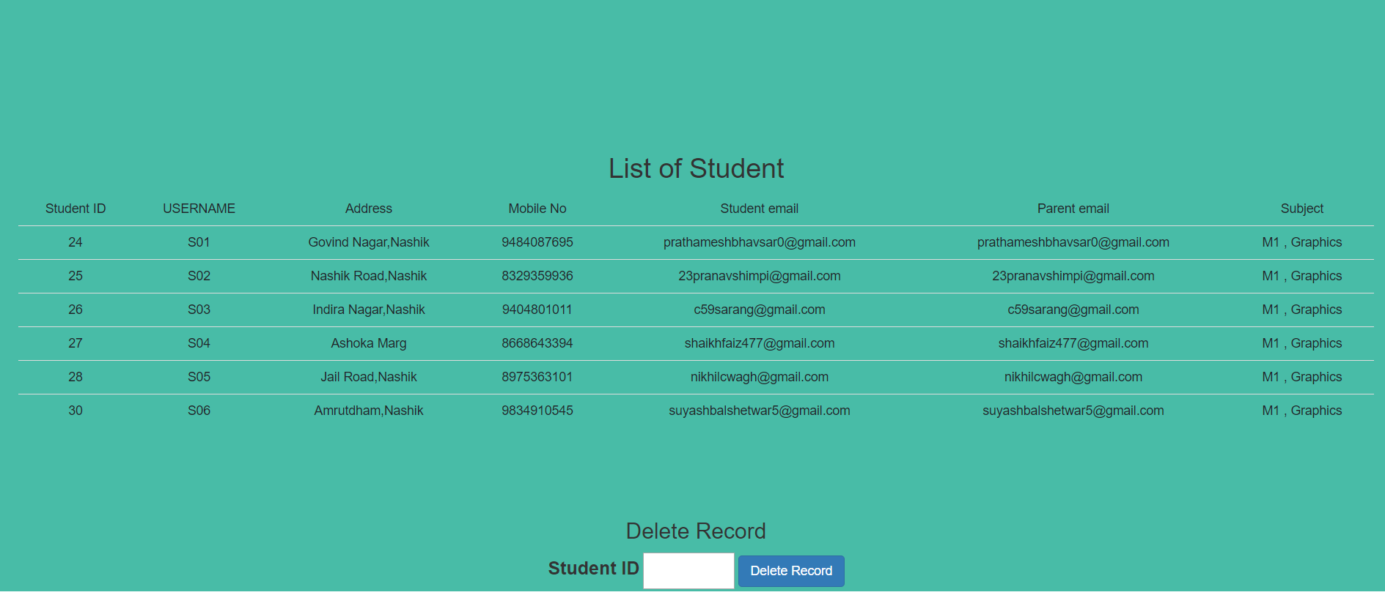
Demo:

Slide 10
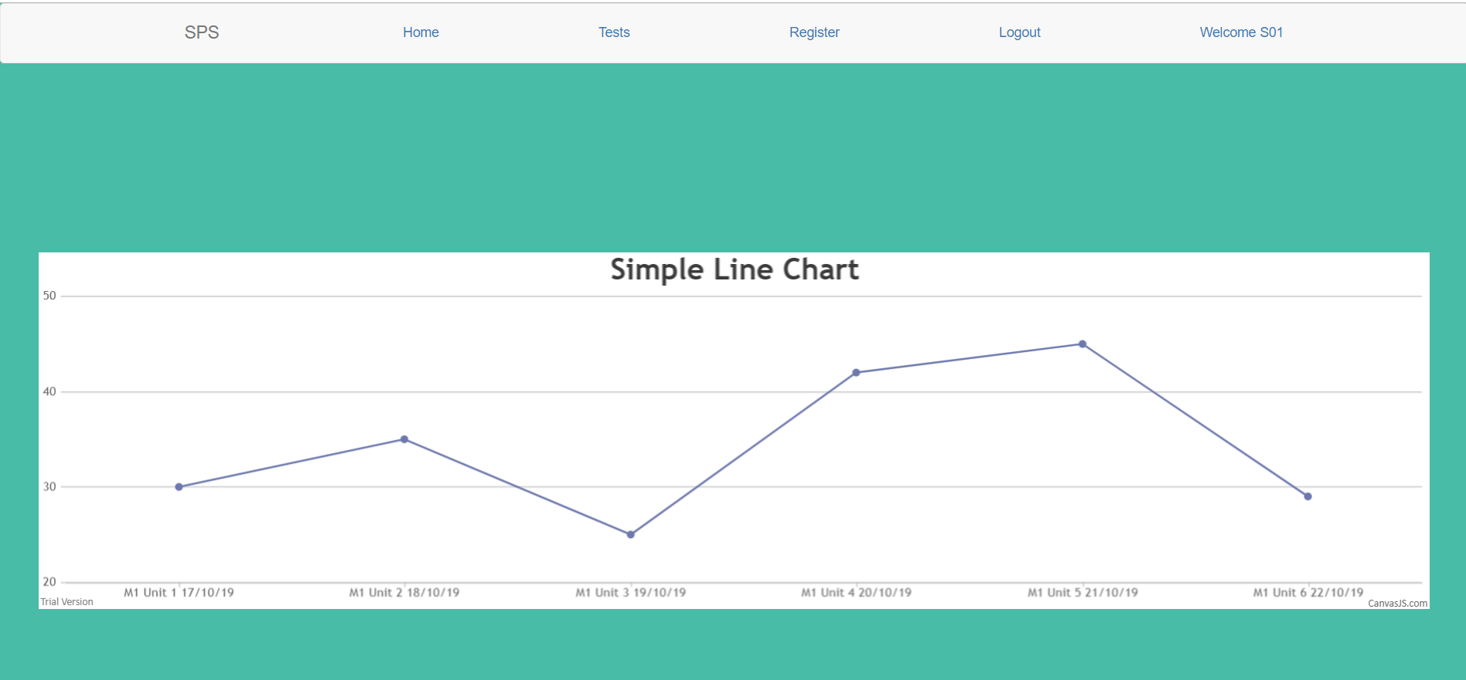
Demo:

Slide 11
Conclusion:
“Coaching Institute Analysis” project developed for an institute has been designed to achieve efficiency and reduce the time taken to handle the activities.
It is designed to replace the existing manual record system thereby reducing the time taken for calculations and for storing data and its analysis.
The implementation of the system in an organization will considerably reduce the data entry, time and also provide readily calculated and analyzed reports.

Slide 12
Q & A:

Slide 13
Future Scope:
The system is interactable and flexible and changes can be made further to increase the efficiency of the Admin.
More updates can be made on the project such as Parent Login, Attendance management, Fees management, Examination Module, Subject module.
This project sample will be helpful to other Coaching Classes as well if modified further or upgraded according to their needs.
Time to time upgradation and post-deployment services will lead to the benefit of both user and developer.

Slide 14

End..

